Slide 1

Airway ALERT
and
CODE AIRWAY
New Clinical Approaches for Difficult Airway Situations
10:31:2016
Supported By:
Patient Safety, Respiratory Therapy, Critical Care, Professional Development Specialists, Rapid Response Team, Intensivists, Anesthesia, Trauma Surgeons, ENT

Slide 2
Objectives
By the end of this presentation, the learner will be able to identify:
The meaning of Airway ALERT and clinical indications that precede Airway ALERT.
How response teams are notified of Airway ALERT.
The meaning of CODE AIRWAY and clinical indications that precede CODE AIRWAY.
How response teams are notified of CODE AIRWAY.

Slide 3
Why do we need Airway ALERT or CODE AIRWAY?
What is Happening?
Several recent events where patient safety issues arose because of the inability to secure an airway
What Should Be Happening?
We need to get the right equipment and the right personnel to the patient with a difficult airway

Slide 4
Which Patients are at Risk for Developing a Airway Issues?
Any patients with neck/oral surgery including:
  Thyroidectomy
  Carotid endarterectomy
  Anterior cervical surgery
Patients with actual or potential for neck/oral swelling (post surgery hemorrhaging, abscess, tumor)
Large body habitus
Peritonsillar abscess, lodged foreign body lodged in airway
Croup
Any invasive lines that are inserted into Jugular vein
Inhalation injuries (burns, chemicals)
Angioedema
Trauma (especially to neck)
References:
http://www.uptodate.com/contents/clinical-presentation-diagnostic-evaluation-and-management-of-central-airway-obstruction-in-adults
Mark L, et al 2015. Difficult airway response team: a novel quality improvement program for managing hospital-wide airway emergencies. Anesth Analg 121:127-139.

Slide 5
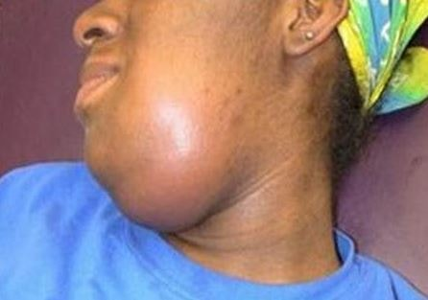
What are Clinical Indications of a Potential and/or Actual Airway Issue?
Increase swelling to upper chest and neck area
Dyspnea
Excessive drooling
Difficulty swallowing
Cough
Hemoptysis
Wheeze
Acute respiratory stridor, respiratory distress
Ludwigs Agina
Obtained from http://healthymouthhealthybody.org.in
References:
http://www.uptodate.com/contents/clinical-presentation-diagnostic-evaluation-and-management-of-central-airway-obstruction-in-adults

Slide 6

When is a Airway ALERT Activated?
Activated in collaboration with a provider when there is concern that the adult or pediatric patient may lose their airway and need intubation however:
  RRT ( can also be RN from ED or OR) notifies on-call Intensivist of serious need
  Time allows for preparation and planning
  Patient can be oxygenated
  Patient remains stable at the time of assessment

Slide 7

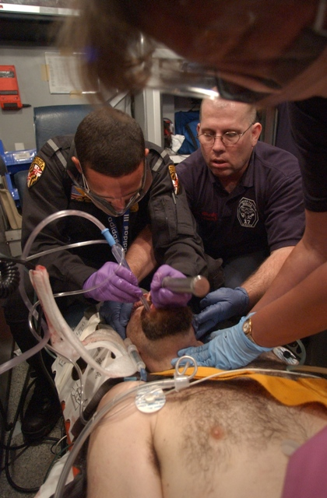
When is a CODE AIRWAY Activated?
Activated in collaboration with provider when there is an inability to intubate the adult or pediatric patient using standard intubation techniques and:
  There is an extreme time pressure
  Extremely difficult or inability to oxygenate
  When a Code Blue is already in progress

Slide 8

Who activates an Airway ALERT?
The following team members may activate an Airway ALERT:
  ED Physicians
  Physician(s) receiving report from RRT
  Rapid Response Team (RRT) (or RN’s from ED and OR)

Slide 9
Who activates an CODE AIRWAY?
The following team members may activate an CODE AIRWAY:
  ED Physicians
  Physician(s) receiving report from RRT
  Rapid Response Team (RRT) (or RN’s from ED and OR)
  Code Blue Response Team

Slide 10

How Do I activate either an Airway ALERT or CODE AIRWAY?
Dial 77
Tell switchboard your name
Airway ALERT: State “Airway ALERT, Adult, Building __, Unit __, Room __,” and the phone extension from which you are calling
Code Airway: State “Code Airway, Adult, Building __, Unit __, Room __,” and the phone extension from which you are calling

Slide 11
Paging an Airway ALERT and CODE AIRWAY
Airway Alert - Team members alerted by pager – not overhead paged
Who is alerted?
  RRT
  ENT
  Anesthesiologist (Anesthesiologist on call after hours)
  ICU Code Blue Pharmacist (Daytime)
  Trauma Surgeon (TRACS)
  House Supervisor
Lets key personnel know that they may be needed to respond to assist with an airway
Allows key members to complete current task in case needed
Code Airway – Team members alerted by Overhead page
Who is alerted?
  Routine Code Blue Response Team and:
  ENT
  Anesthesiologist (Anesthesiologist on call after hours)
  Trauma Surgeon (TRACS)
  Personal radio-page, beepers will be activated as well as overhead page

Slide 12
What Should You Do if you Suspect an Airway Issue?
Call Rapid Response Team (RRT)
Call RRT as soon as you have a concern about the patient’s airway (neck edema, respiratory issues etc.)
Stay with the patient
Call other nearby staff for immediate assistance
CALL CODE BLUE if patient stops breathing or worsens before RRT arrives

Slide 13
Is There Special Equipment Needed for Airway ALERT or Code Airway?
Special Intubation Equipment on Bronchoscopy Cart in ICU
  - Brought by the ICU RT who is not assigned that shift to Rapid Response Team
2. Surgical Tracheostomy Box in ICU
  Stored on Bronch cart
3. Code Blue Backpack in ICU
  Brought by the Critical Care Tech or ICU charge nurse
  (ED and OR will not need backpack contents)

Slide 14

For any questions please contact any of the following:
Ann Alway, 46107
Bill Cohagen, 43110
Ryan Mackey, 42791

Slide 15

Thank You

