Slide 1


Respectful Workplace
Preventing Workplace Harassment and Discrimination
1
Notes:
Welcome to our short training on maintaining a respectful workplace by preventing workplace harassment and discrimination.

Slide 2

Respectful Workplace Defined
At Salem Health, all individuals have the right to work in an environment in which all people are treated with dignity, decency and respect, characterized by mutual trust and respect, and the absence of intimidation, oppression and exploitation
Practitioners are expected to demonstrate behaviors that reflect a commitment to continuous professional development, ethical practice, an understanding and sensitivity to diversity, and a responsible attitude toward their patients, their profession and society
No patient, employee, or provider harm is acceptable to us at Salem Health. Engaging in, condoning, and/or not reporting discrimination, harassment or retaliation is in direct conflict with our values and is not tolerated
As an organization committed to demonstrating respect for people in a learning culture, this training helps provide our workforce members the knowledge and skills to ensure our values are upheld at all times.
Notes:
[read bullet points]

Slide 3

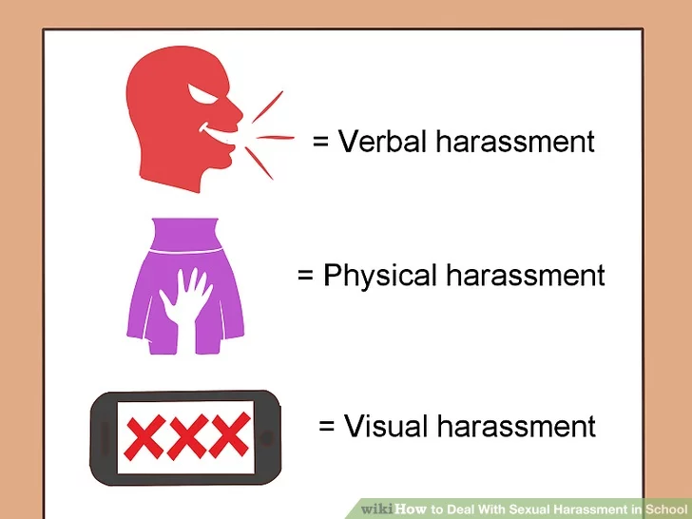
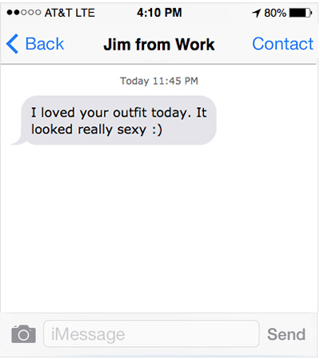

Sexual Harassment is:
Physical
Visual
Written
Verbal
Pam
or
or
or
Conduct or Actions of a sexual nature that are
Unwelcome
Unwanted
Severe
or
and
Notes:
Sexual harassment is defined as: “unwelcome sexual advances, requests for sexual favors, and other verbal or physical conduct of a sexual nature when submission to or rejection of such conduct is used as the basis for employment decisions ... or such conduct has the purpose or effect of ... creating an intimidating, hostile or offensive working environment.” [read slide…’can be physical or visual or…]

Slide 4
Examples of Sexual Harassment
Relentless pressure for sex
Threatening professional consequences unless sexual demands are met
Unwanted groping or stroking
Intentional touching of intimate body areas
Continuously asking an employee out on a date after they said “no”
Unnecessary touching, patting, pinching or brushing of another’s body (such as shoulder rubs)
Jokes or stories in a sexual manner
Stalking (including telephone, texting, and social media)
Staring, elevator eyes
Repeated comments about an individual’s body, clothing, or lifestyle which have sexual implications
Showing/ sharing images, memes or photos of a sexual nature
Sexual teasing or sexist insults (such as ‘are you sure you can do this job with small kids at home?’)
Unwanted sexual discussions
Witnessing sexual harassment in the workplace and failing to intervene and/or failing to report the incident to a leader or Human Resources
Notes:
Here are some examples of sexual harassment. While this list is not exhaustive, it helps to provide a shared understanding of the type of behaviors that can be considered sexual harassment and not permitted in the workplace. Examples included unnecessary touching, patting, pinching or brushing of another’s body such as shoulder rubs, staring or elevator eyes, repeated comments about an individual’s body, clothing or lifestyle that have perceived sexual implications, or sexual discussions.
We also need to be mindful of visual conduct, including any sexually suggestive objects, or written or graphic material, including calendars, posters and cartoons that are sexually suggestive, suggestive or insulting sounds; leering; staring; whistling; obscene gestures; content in letters, photos, text messages, tweets and Internet postings; or other forms of communication that are sexual in nature and offensive.
Every member of the healthcare team, whether employed by Salem Health Hospitals and Clinics or not, is expected to prevent sexual harassment, intervene in any incident of sexual harassment they observe, and report any incident that is witnessed or raised to them.

Slide 5
What is a Hostile Work Environment?
Pervasive and persistent behavior within the workplace that has the purpose or effect of creating an environment that is difficult, or uncomfortable for another person to work in, due to their protected status, i.e. sex, gender, gender identity or expression, race, religion, disability… etc.
They keep making comments about my body on social media. I don’t think I can keep working here.
Notes:
You may have also heard the term hostile work environment used in relation to harassment.
[read slide]
Common complaints in a sexually hostile environment include suggestive remarks, fondling, or sexually suggestive photos in the workplace. An employer can be held liable for failing to prevent these types of workplace conditions.

Slide 6


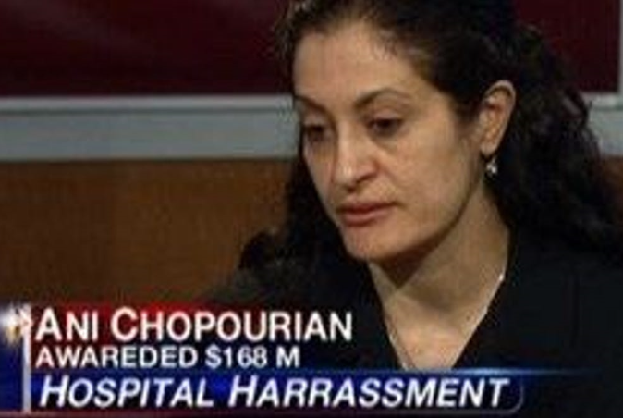
Risk to Organizations and Individuals who Violate
Physician assistant says she was tormented in cardiac surgery unit.
Notes:
This is a real example of a case in the not too distant past.
Ani Chopourian, a Physician’s Assistant at a California hospital, says she was tormented in the Cardiac Surgery unit from 2006 to 2008. On March 2, 2012 Ani Chopourian won a $168 million dollar lawsuit against the hospital after a jury trial where she described that she was tormented and sexually harassed by surgeons and the medical staff in the cardiac surgery center, including witnesses who confirmed the conduct that was described as a "raunchy, vile, toxic workplace" in which she was targeted by harassers because she continued to complain about the working atmosphere. This is an example of why it is so critical to ensure we have a professional work atmosphere where all workforce members are treated with respect, and that all concerns are taken seriously.

Slide 7


Responding to Harassment or a Hostile Work Environment
If you experience or witness harassment, here is what you should do immediately:
Talk to the harasser and let the person know their actions are unwanted and unwelcome. Document this request. If you are hesitant about having this conversation by yourself, talk to Human Resources immediately.
If you witness harassment, intervene if possible, and document the intervention. If not possible, report what you witnessed to HR.
If a coworker tells you about harassment they experienced at work, direct them to talk to their supervisor and/or HR.
To report and/or seek assistance in responding to a harasser, reach out to HR and be prepared to share all the details you can.
Notes:
Read slide

Slide 8
What can you do?
Consider what a “professional” work environment looks like. It’s ok to have fun, but don’t tolerate vulgar jokes, innuendo, or behaviors that make workforce members feel uncomfortable.
Don’t settle for “oh, that’s just _____” or make excuses for inappropriate conduct.
If someone uses words like uncomfortable, unsafe, harassment, hostile work environment, or discrimination, report it right away.
If someone makes a complaint and then says “but I don’t want you to do anything”, tell them you have an obligation to address it.
Avoid any behavior that could be perceived as retaliation, such as trying to find out who raised a concern, or ignoring someone that you think may have raised a concern. If you experience behavior that seems to be retaliation, report it to HR.
Notes:
So what is expected of you?
[read slide]

Slide 9
Prescriptions for a Respectful Workplace
Respectful Workplace Conduct Examples
Offering help when a coworker is having a hard time
Respecting a coworker’s background and beliefs
Respecting a coworker’s privacy
Asking your team for ideas
Voicing appreciation for a completed work task
Seeking a coworker’s opinion in a meeting
Politely voicing your disagreement and offering a solution
Assume positive intent
Seek to understand the viewpoint of others
Always consider your actions and their impact
Respectfully share ideas or concerns
Listen and seek input from other members of the care team
Voice appreciation to others
Value diversity in all forms
Attempt to resolve differences in the spirit of cooperation
Treat each person with courtesy, respect and decency
Challenge inappropriate behavior and refuse to be a participant
Notes:
All members of the workforce can help us maintain our respectful work environment by following these prescriptions [read bullet points]

Slide 10
Thank You!
10
Notes:
[close]

